Slide 1

Building Opportunities for Optimized Trade and Investment for Growth in East & Southern Africa (BOOST) - P512862
BOOSTING TRADE, INVESTMENT & FINANCE
FOR JOBS & GROWTH
Transforming the trade, investment and finance landscape in East & Southern Africa

Slide 2
Trade isn’t delivering growth (and therefore jobs) in the region
Africa underperforms in trade —by 20 % of GDP—with intra‑East African trade at just 6 % of GDP.
Export growth is insufficiently job-creating
Low Trade Diversification
High Trade Costs
Underperforming Investment
Limited Finance
Concentration: Primary, low value, & low-productivity sectors
Slow, unreliable and costly corridors
Limited spillovers to domestic firms & jobs
Firms struggle to scale, export, and absorb labor
Diversification: 1.3x lower than East Asia
Time: Over 40% of time lost to borders and delays
FDI stock: ~ 20% less than comparators and extractive focused
Private credit: 18% of GDP against a Benchmark ~ 41% (SSA)
Notes:
Trade as a % of GDP in East Africa is below Sub-Saharan Africa.( Except Rwanda, Djibouti, Somalia). Compared to 40% in the Regional Comprehensive Economic Partnership (RCEP) and 60% within the European Union (EU)
GVC participation in Africa is skewed toward upstream (forward) linkages, but growth, jobs, and technology spillovers come mainly from downstream (backward) participation.
Africa’s exports to the rest of the world are heavily concentrated in primary commodities—fuels, metals, and raw agricultural goods. These sectors are low in complexity, have limited domestic linkages, and are exposed to price volatility.
Other Data points:
Less complex, low volume or limited number of products
Harvard Atlas - No. of products added (2008-2023):
Rwanda 12
Kenya 16
Ethiopia 22
Tanzania 23
Uganda 32
New analytical decompositions of trade costs reveals that the dominant frictions costs are not tariffs but unilateral, or behind-the border, and regulatory barriers. About 60% of total trade costs stem from unilateral sources. These arise mainly from domestic institutional constraints: customs clearance inefficiencies, unaligned regulatory frameworks, sub-optimal logistics services, transit fragmentation and poor infrastructure. Second key sources of frictions are bilateral frictions at border posts including divergent product standards, non-mutual recognition of licenses and permits, and weak transit regimes further compound the problem.
Data sources:
1.3x diversification: The trade index of Global Economic Diversification Index (EDI) https://economicdiversification.com/region/sub-saharan-africa/
1091.83/11= 99.25 East Asia average (Malaysia, Mongolia, Philippines, Singapore, Thailand, Vietnam, Cambodia, China, Indonesia, Japan, Korea)
384.81/5 = 76.96 Average for project countries where data is available. (Uganda, Tanzania, Rwanda, Kenya, Ethiopia)
40% time: Kenya Economic Update June 2024. (Kenya)
FDI stock: Africa East FDI analysis (Kenya, Ethiopia, Rwanda, South Sudan and Djibouti)
Private credit: World development indicators. Private sector credit by country: Kenya (31.6) Rwanda (22.6) South Sudan (5.4) Uganda (14.4) SSA (29.7) Tanzania (16.8)

Slide 3
However, the Trade Integration Opportunity is Now!
1
Global trade uncertainty is rising: Continental and regional integration offers more stable market access amid fragmentation
2
AfCFTA is ready for implementation: Legal foundations are complete – all protocols have been adopted in 2025. The binding constraint is now execution
3
Regional trade supports diversification and resilience: Intra-African trade is more diversified and jobs-intensive than trade with the rest of the world
11 of Africa’s 16 landlocked countries are in East & Southern Africa with a median GDP of US$14 bn. National markets lack the density to support diversified production, industrial agglomeration, or modern service exports.
Notes:
1. For African countries historically marginalized in global production networks, this fragmentation could reinforce exclusion, unless they reposition themselves through regional hubs of production and trade.
The evidence shows that countries with stronger regional integration are also better positioned to integrate globally. Regional integration provides the scale and connectivity needed to increase competitiveness in global markets. Africa, more than any other region, remains acutely vulnerable to external trade shocks. The recent withdrawal of AGOA benefits.
2. Phase II and III protocols covering competition, investment, digital trade, and e-commerce provide the scaffolding for a deeper continental agreement. But success depends on three design principles: allowing variable geometry to let frontrunners lead, making commitments binding and monitored, and building flexibility into implementation without sacrificing ambition.
3. Though smaller in volume (15-17% of exports), intra-African trade is more diversified and more manufacturing, featuring a significantly higher share of processed agriculture and foods, textiles, light manufactures, and transport equipment. This trade composition has higher potential for creating jobs, fostering innovation, and developing industrial capabilities.
4. Regional integration addresses this structural limitation by pooling demand, lowering average production costs, and enabling the emergence of regional value chains (RVCs). Particularly in sectors—such as agro-processing, automotive components, and light manufacturing— that would be otherwise subscale at the national level

Slide 4
Addressing constraints across the trade-investment-finance ecosystem will be important to achieve integration outcomes
Dimensions
Channels
Expected Outcomes
Regional
Continental and regional agreements
Reduced trade costs and delays
Improved predictability of cross border trade
Physical
Border infrastructure and logistics services
Expanded access to regional markets for firms
Digital
Trade systems, payments, data
Increased access to trade finance and risk mitigation
Financial
Trade finance and risk instruments
Stronger alignment of regional trade and investment
Regulatory
Rules, standards, and investment climate
Notes:
Interoperability is the operating system of integration. It is the capacity of data, goods, finance, regulation, logistics, and institutions to operate seamlessly across borders.

Slide 5
The Proposed BOOST program concept
Program will aim to reduce trade costs, increase investment flows, expand finance for exports, and increase regional trade coordination.
Pillar I: Trade & Investment for Jobs
Pillar II: Financing for Exports & Private Capital
Pillar III: Regional Coordination & Delivery
Implement trade agreements (AfCFTA, WTO, regional).
Improve trade efficiency (automation, border management, quality infrastructure).
Support investment and regulatory reforms.
Expand trade finance instruments in priority export-oriented value chains.
Introduce de-risking instruments and trade insurance.
Strengthen digital cross-border payment.
Strengthen regional coordination
Facilitate private sector platforms for collaborative joint action.
Geographic scope covers countries in East and Southern Africa where interventions will be aligned along corridors and value chains that will help concentrate investment, reforms, and partnerships where trade flows.

Slide 6
Proposed BOOST concept in Ethiopia
Objective: Increase trade efficiency, mobilize private investment, and expand export finance
Trade & Investment
Trade Finance
Regional Coordination & Delivery
Support WTO Accession, AfCFTA Support, HOAI activities
Modernize hard and soft border infrastructure
Automate and digitize trade
Support Coordinated border and risk management and joint procedures
Support trade in services
Reduce non- tariff barriers (NTBs)
Support Compliance with trade rules on SPS, TBT, standards
Promote investment
Improve investment climate
Exploring support to high potential SME exporters in selected value chains potentially through
  pre-shipment working capital loans
  post-shipment finance
  Export credit insurance (e.g., guarantees)
Strengthen regional coordination
Facilitate private sector platforms for collaborative joint action

Slide 7
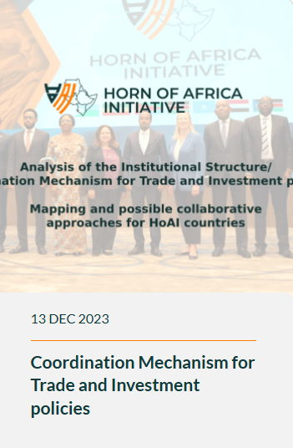
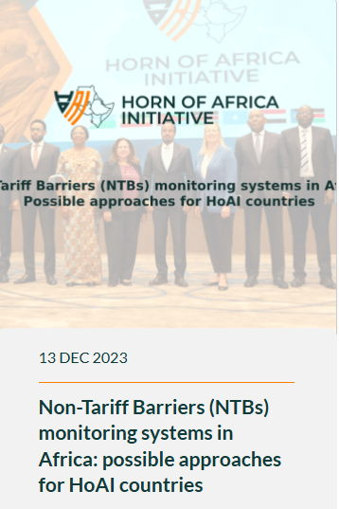
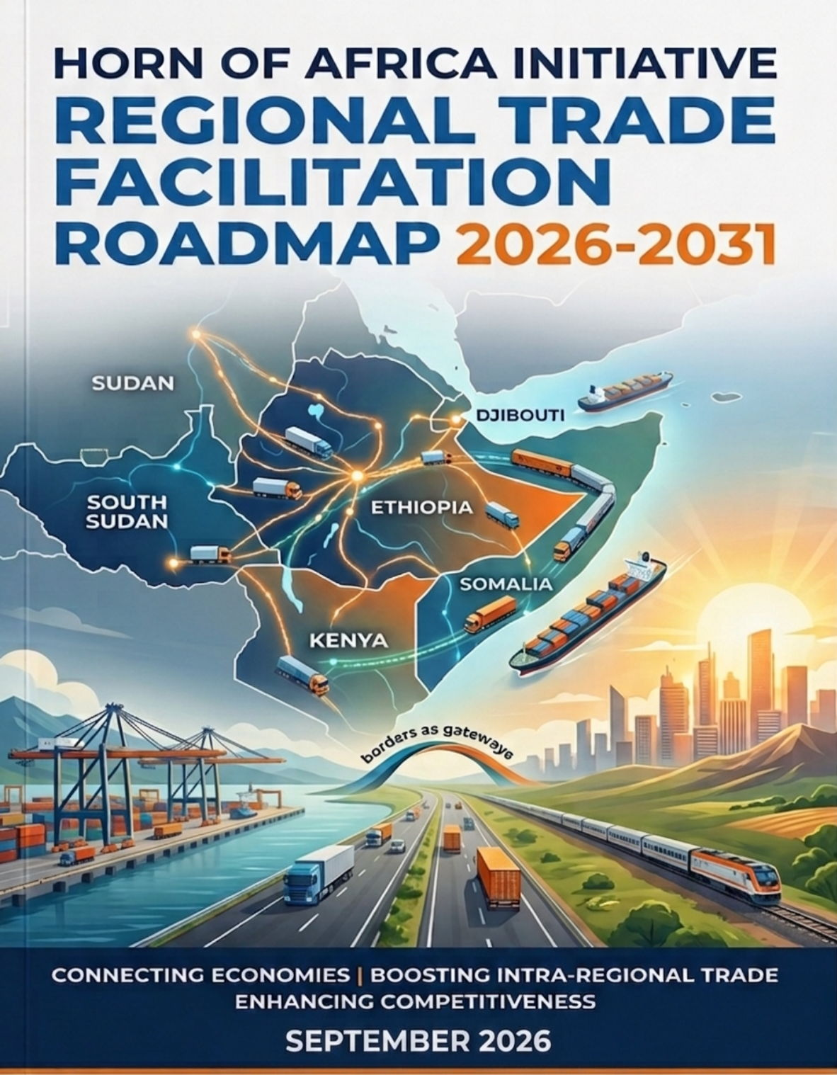


HoAI played a major role in shaping the preparatory work behind BOOST's design in Ethiopia
  BOOST Ethiopia supports several priority strategic goals of the Roadmap (2026–2031) including:
  NTB resolution mechanisms (Goal 1),
  Simplified Trade Regimes (Goal 2),
  Time Release Studies (Goal 4)
  Advancing AfCFTA regulatory alignment (Goal 13)
  as well as several others supporting regional activities that advance border coordination, cross-border data interoperability, and other regional frameworks.
HoAI Pillar 2: Economic and trade integration
Notes:
Roadmap’s 14 goals
Strengthen collaboration mechanisms for NTB identification, reporting, and resolution through a permanent regional coordination platform.
Implement Simplified Trade Regimes (STRs) at HoAI borders to facilitate small-scale cross-border trade, with particular focus on women traders.
Develop a regional portal connecting national Trade Information Portals into a single interoperable access point for traders.
Conduct joint Time Release Studies (TRS++) at priority border posts and develop joint action plans based on findings.
Establish mutual recognition of cross-border road transport permits to reduce administrative barriers along regional corridors.
Establish interoperable Electronic Cargo Tracking System (ECTS) frameworks for end-to-end monitoring of goods along strategic corridors.
Develop a Regional Road Corridor Management Information System (RRCMIS) to monitor the condition and performance of priority trade corridors.
Establish a Regional Border Management Coordination Forum and institutionalize Joint Border Committees at HoAI border posts.
Establish a regional framework for cross-border data sharing and interoperability among customs and border agencies.
Develop dedicated fast-track lanes for Authorized Economic Operators (AEOs) and progressively establish a regional AEO+ mutual recognition programme.
Establish a regional framework for interoperable digital payments for customs duties, border fees, and other cross-border charges.
Support the full operationalization of the DESSU Corridor Authority and Transport Observatory.
Support implementation of AfCFTA Protocols through coordinated regulatory alignment and institutional capacity building.
Optimize Pre-Arrival Processing (PAP) systems to accelerate cargo clearance and improve predictability of trade flows.

Slide 8

LIVESTOCK TRADE FACILITATION
A focused reform agenda for the Ethiopia–Djibouti–Somalia corridor
Shift from a broad diagnostic to a sequenced program of policy, process and investment decisions.
HIGH-LEVEL ISSUES
PRIORITY REFORMS
DECISIONS NOW
Executive objective
Agree who leads, what moves first, and how delivery will be measured.

Slide 9
1 | EXECUTIVE DIAGNOSIS
Four issues are holding back corridor performance
The constraints reinforce each other, raising cost, delay, compliance risk and unpredictability.
1
Infrastructure & logistics
2
Rules & institutional coordination
Weak feeder roads, limited fit-for-purpose transport, inadequate holding and quarantine capacity, and insufficient livestock handling at the port.
Misaligned veterinary standards, complex certification, inconsistent trade policies, fragmented agency roles and weak bilateral coordination.
3
Health, compliance & welfare
4
Digital, capability & commercial enablers
Disease-control gaps and inefficient quarantine procedures increase operational delays, cost and risks to animal health and welfare.
Limited e-documentation and data exchange, skills gaps, technical-assistance needs and restricted access to suitable trade finance.
Management implication
Treat the corridor as one end-to-end operating system, not as a collection of isolated infrastructure projects.

Slide 10
2 | PRIORITIZATION
Sequence reforms so early coordination unlocks larger investments
Start with decisions and process simplification, then pilot systems and upgrade operations before scaling infrastructure.
0–6 MONTHS
6–18 MONTHS
18+ MONTHS
ALIGN & SIMPLIFY
PILOT & UPGRADE
MODERNIZE & SCALE
Activate bilateral technical mechanism
Upgrade critical holding and quarantine operations
Modernize corridor and port handling infrastructure
Map and simplify export journey
Pilot e-certification and data exchange
Scale interoperable traceability
Agree priority veterinary and documentation requirements
Joint training for veterinary and customs officials
Expand tailored trade-finance solutions
Sequencing principle: avoid major capital commitments before governance, standards and operating processes are agreed.

Slide 11
3 | DECISION AGENDA
Four immediate decisions to move from diagnosis to delivery
The meeting should close with named ownership, agreed priorities and a time-bound action plan.
1
GOVERNANCE
Designate lead agencies and establish a routine bilateral coordination forum.
Who leads and how often the mechanism meets
2
PRIORITIZATION
Select the highest-impact border, quarantine, transport and port bottlenecks.
Which constraints enter the first delivery package
3
PROCESS REFORM
Define simplified procedures, mutual-recognition steps and documentation standards.
What can be harmonized or simplified now
4
DELIVERY PLAN
Assign responsibilities, milestones, financing needs and measurable performance indicators.
Who delivers what, by when, with what resources
Decision test: faster, safer and more predictable livestock movement to export markets through Djibouti.

