Slide 1

ECOTRADE Project
Promoting Ethiopian Trade and Economic Integration through Private-Led Value Chains Development
Implemented by:

Slide 2






Key Project Information
Output 1
Promote active private sector engagement in the implementation of the AfCFTA
€6.8 million
Output 2
Promote regional value chain integration and trade
Output 3
Support relevant authorities in implementation of the AfCFTA agreement
Output 4
Support for academic and/or research institutions
4 years (2025 – 2029)
Output 5
Enhance Ethiopia’s readiness to implement the AfCFTA DTP

Slide 3
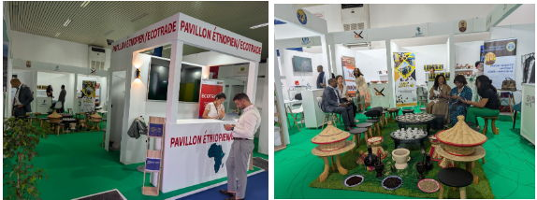

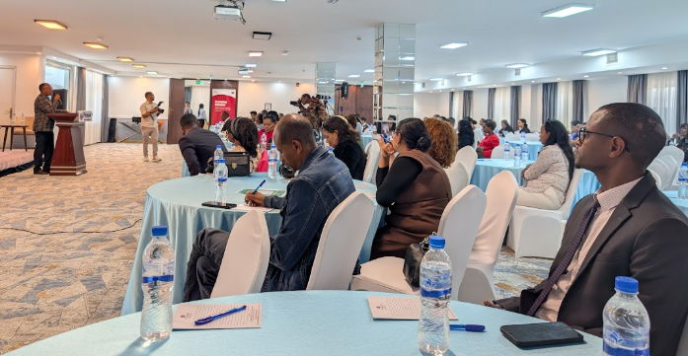
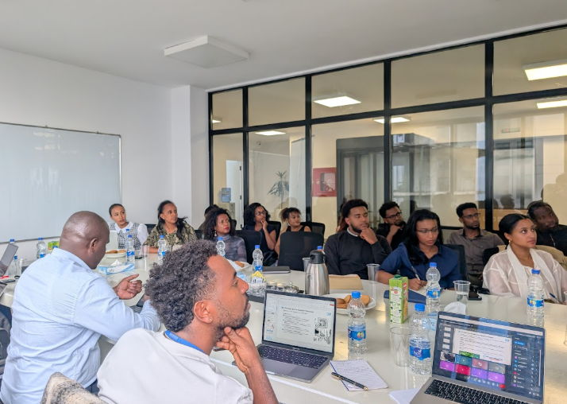
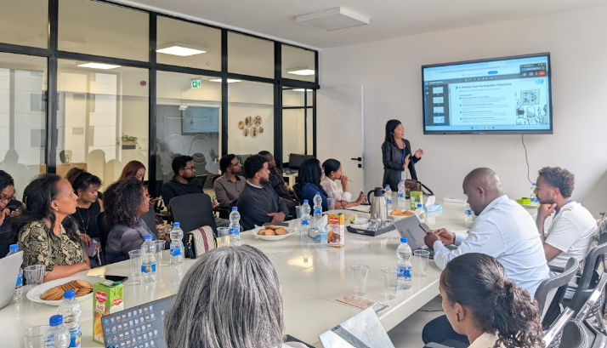
Project Activities
& Impact.
Activity Type: Access to Market and Trade Facilitation
Status: Completed
Outcomes:
17 Ethiopian SMEs exhibited to over 35,000 participants, in addition to key officials from the Ministry of Trade and Industry engaging with other national counterparts resulting in knowledge exchanges
A total of $202.5 million in signed contracts and preliminary agreements
Intra-African Trade Fair 2025
Output 1
Promote active private sector engagement in the implementation of the AfCFTA
Capacity Building for SMEs
Activity Type: Technical Assistance
Status: Ongoing (Phase 1: May 2026 – April 2027)
Anticipated Outcomes:
Shifted from generic training programs to demand-driven technical support
Assessed the export readiness of 90 SMEs
Development of tailored intervention including market intelligence, hands-on training and business matchmaking
Export performance to be enhanced and actual trading under the AfCFTA to be realized

Slide 4
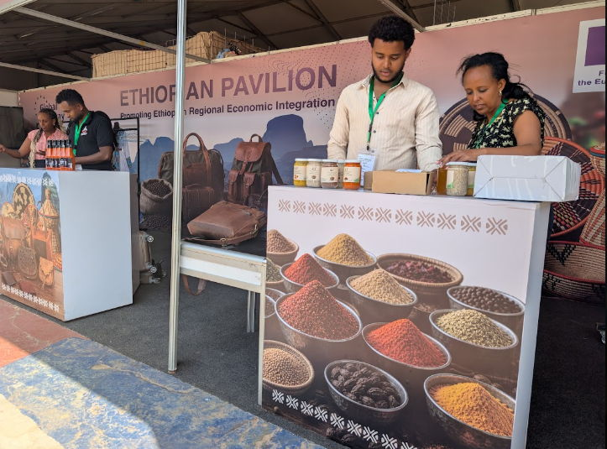
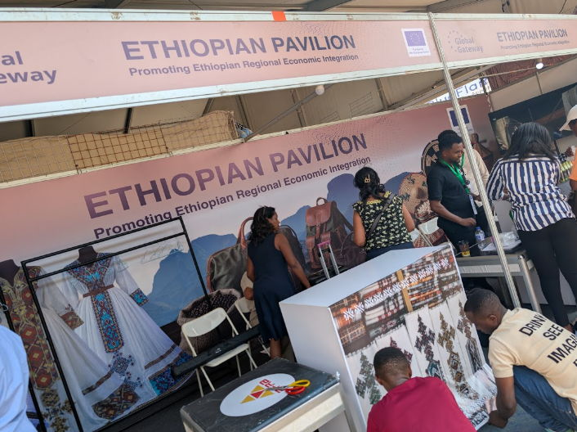
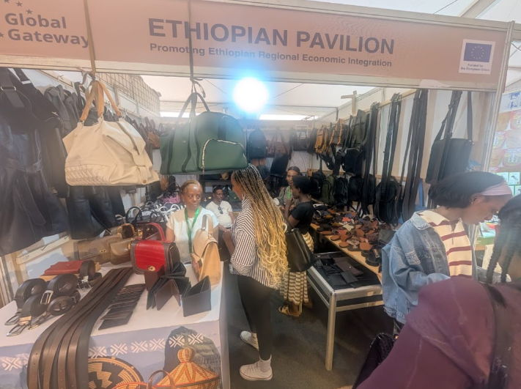
Project Activities
& Impact.
Activity Type: Access to Market and Trade Facilitation
Status: Completed
Outcomes:
18 Ethiopian SMEs exhibited to over 2400 visitors; increasing the visibility of Ethiopian products
Advanced commercial negotiations between the largest retail supermarket in Kigali (Simba Supermarket) and 2 Ethiopian SMEs: export deals to be realized following this
Strengthened dialogue between the AfCFTA Secretariat, private sector players and development partners through a panel discussion on measures to increase to cross-border trade for women-led businesses
Rwanda Int’l Trade Fair 2026
Output 1
Promote active private sector engagement in the implementation of the AfCFTA
Activity Type: Technical Assistance (Study)
Status: Completed
Outcomes:
Established a roadmap for strengthening public–private dialogue (PPD) on AfCFTA implementation
Provided an implementation roadmap for results-oriented PPD
Public-Private Dialogue Diagnostic Study

Slide 5
Project Activities
& Impact.
Output 2
Promote regional value chain integration and trade
Ethiopia-Algeria Coffee Trade Facilitation
Activity Type: Access to Market and Trade Facilitation
Status: Ongoing
Expected Outcomes:
A clear diagnostic report outlining key bottlenecks in Ethiopia-Algeria coffee trade
At least five pilot direct supply agreements between Ethiopian exporters and Algerian buyers
Strengthened institutional dialogues between trade authorities of both countries
Increased awareness among Ethiopian exporters of Algerian market requirements

Slide 6
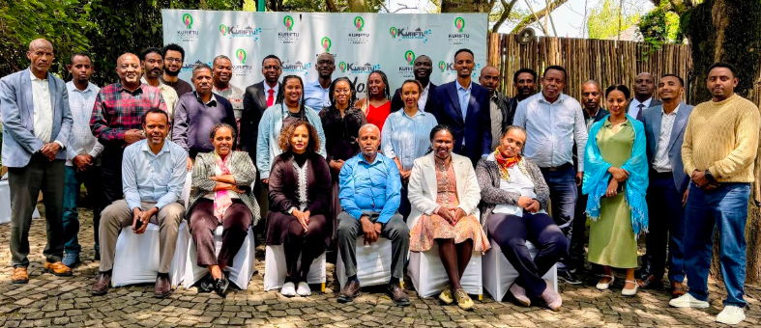
Project Activities
& Impact.
Activity Type: Validation Workshop/Forum
Status: Completed
Outcomes:
Validated findings and recommendations on Ethiopia's implementation of the AfCFTA Trade in Goods Protocol
Provided MoTRI and other government institutions with evidence-based recommendations to strengthen implementation
AfCFTA Implementation Review Mechanism
Output 3
Support relevant authorities in implementation of the AfCFTA agreement
Activity Type: Technical Assistance
Status: Completed
Outcomes: (committed Expert days in technically reviewing these policy/trade documents)
Final version of the AfCFTA Step-by-Step Guide ready for validation
AfCFTA Draft Report has been submitted to the National Implementation Committee
The finalized National Trade Policy document to be launched at the upcoming National Trade Week
Technical Assistance: AfCFTA Step-by-Step Guide + National Trade Policy + AfCFTA Draft Report

Slide 7
Project Activities
& Impact.
Activity Type: Validation Workshop/Forum
Status: Planned (September 15-16, 2026)
Expected Outcomes:
A validated trade tool with clear next steps on disseminating the Trade Document
Strengthened engagement between the Government and the Private Sector on AfCFTA implementation
AfCFTA Step-by-Step Guide
Output 3
Support relevant authorities in implementation of the AfCFTA agreement
Activity Type: Workshop/Forum
Status: Planned (September 3-6, 2026)
Expected Outcomes:
Launch of the National Trade Policy (project contributed to the development of this policy)
Strengthened national coordination and stakeholder collaboration to advance Ethiopia's trade agenda and AfCFTA implementation
National Trade Week, Ethiopia

Slide 8
Project Activities
& Impact.
Output 3
Support relevant authorities in implementation of the AfCFTA agreement
Sanitary and Phyto-sanitary Compliance for Improved Trade
Activity Type: Technical Assistance
Status: Planned (September 21-23, 2026)
Expected Outcomes:
Enhanced awareness of AfCFTA Annexes on sanitary and phyto-sanitary compliance in enabling SMEs to comply with regional standards and further leading to improved trade rather than its lack of awareness serving as a non-tariff barrier to trade
A stronger national network of agripreneurs, regulatory institutions and technical experts is established to promote collaboration, share best practices and support continuous improvement in SPS compliance across agricultural value chains

Slide 9
Project Activities
& Impact.
Activity Type: Technical Assistance
Status: Completed
Outcomes:
Identified and prioritized high-potential AfCFTA markets, providing Ethiopia with an evidence-based roadmap to strengthen oilseed exports through targeted trade promotion, market intelligence, and business development initiatives
Developed recommendations to improve access to finance, promote value addition and processing and enhance compliance with regional standards, increasing the competitiveness of Ethiopian oilseed exports
Provided a framework for strengthening public–private collaboration, building the capacity of producers and exporters, and developing a sequenced implementation roadmap to maximize Ethiopia's utilization of AfCFTA opportunities in the oilseed sector
Oilseeds in Ethiopia: Mapping AfCFTA Market Access and Overcoming Barriers to Private Sector-Led Trade
Output 4
Support for academic and/or research institutions
Activity Type: Technical Assistance
Status: Planned
Expected Outcomes:
A comprehensive AfCFTA course is developed, equipping students with practical knowledge and expertise on regional trade
A partnership is established between Addis Ababa University and the Nelson Mandela School (University of Cape Town), leading to academic exchanges, joint research and publications
Development of an AfCFTA Course + Academic Exchanges + Joint Publications

Slide 10
Project Activities
& Impact.
Development of e-Platforms for SMEs
Output 5
Enhance Ethiopia’s readiness to implement the AfCFTA DTP
Activity Type: Technical Assistance
Status: Planned
Expected Outcomes:
SMEs gain improved access to regional and continental markets through digital platforms that facilitate business networking, market information, product promotion, and buyer–seller connections: increasing their participation in intra-African trade
SMEs adopt digital tools and platforms to improve business operations, market intelligence and engagement in cross-border trade - enhancing their competitiveness and readiness to leverage opportunities under the AfCFTA Digital Trade Protocol

Slide 11
ECOTRADE Project
Thank You
Promoting Ethiopian Trade and Economic Integration through Private-Led Value Chains Development
Implemented by:

