Slide 1

Regional Trade Facilitation roadmap 2026-2031
Connecting Economies, Boorsting Intra-Regional Trade, Enhancing Competitiveness

Slide 2
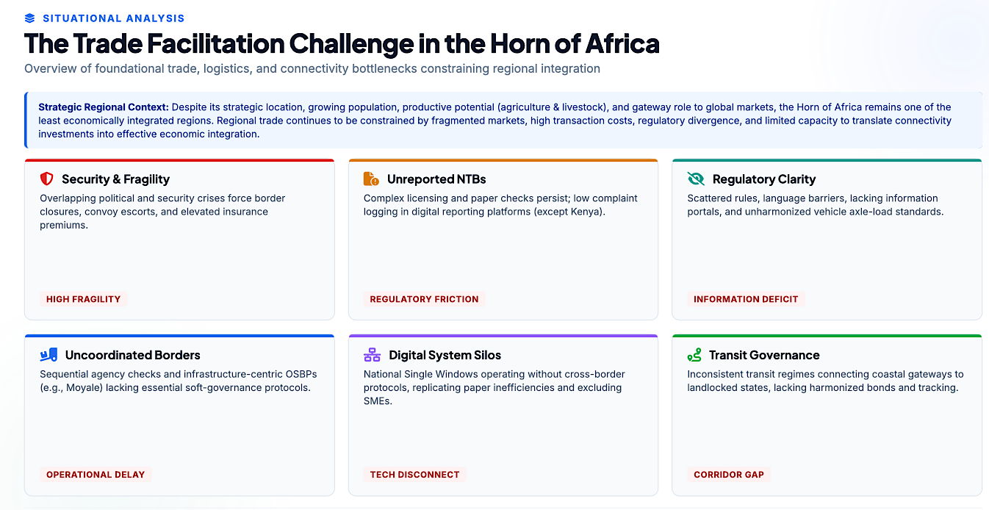

Slide 3
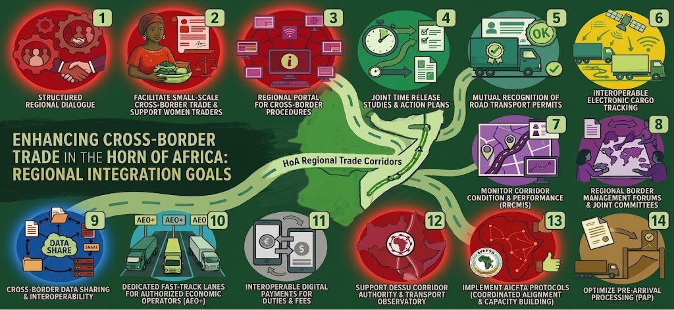

Slide 4
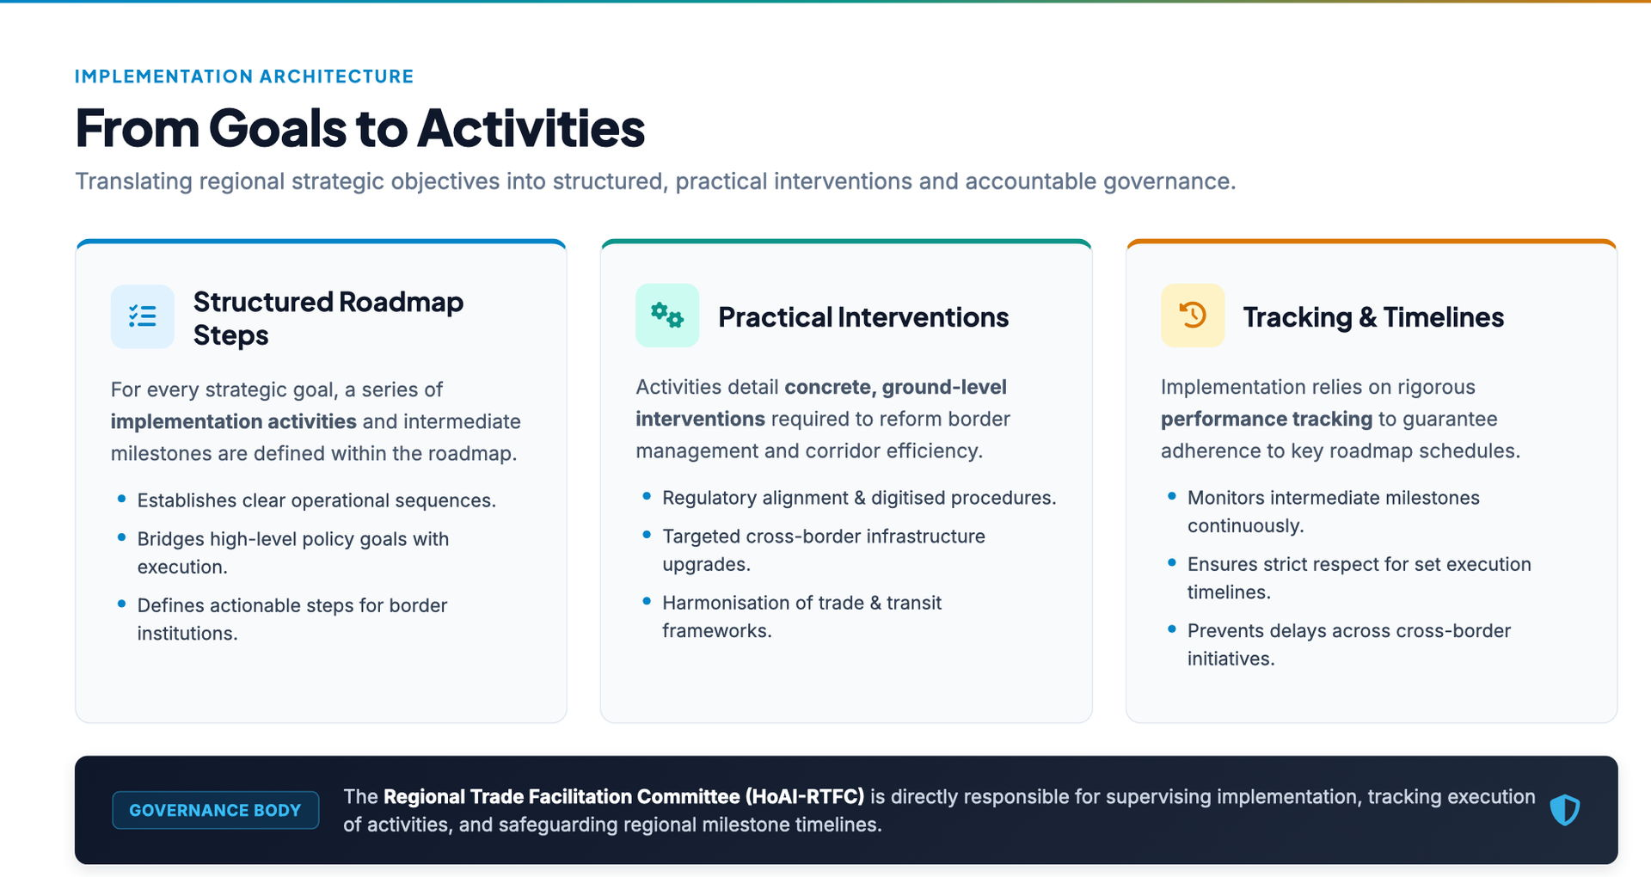

Slide 5
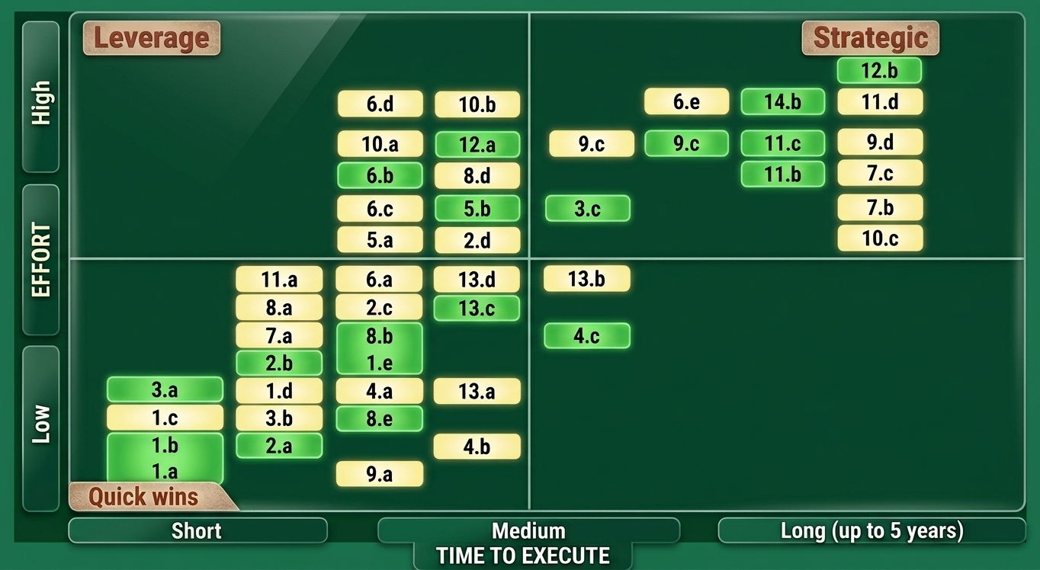

Slide 6
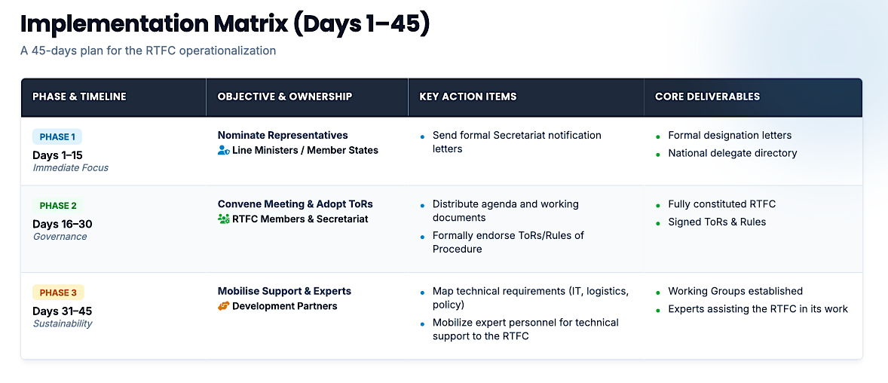

Slide 7
Thanks for your attention

